Slide 1


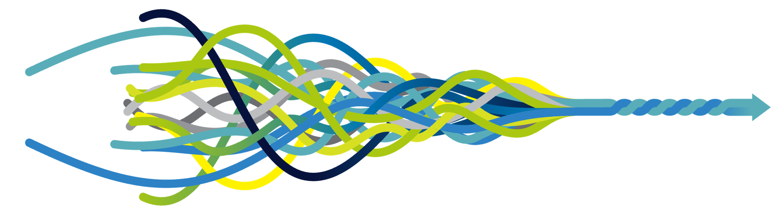
Putting People at the Centre of Their Research Journey
Bruce Hellman
Co-Founder and Chief Patient Officer
uMotif

Slide 2
My journey: The start
People
with Parkinson’s

Slide 3
My Journey: Today
People
and Clinical Trials

Slide 4
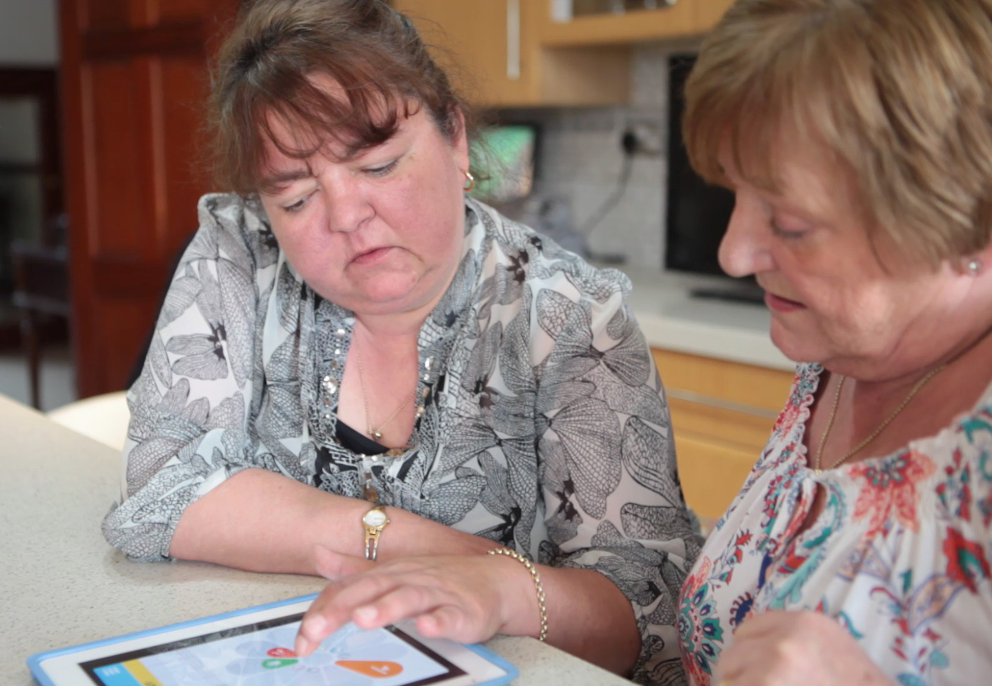
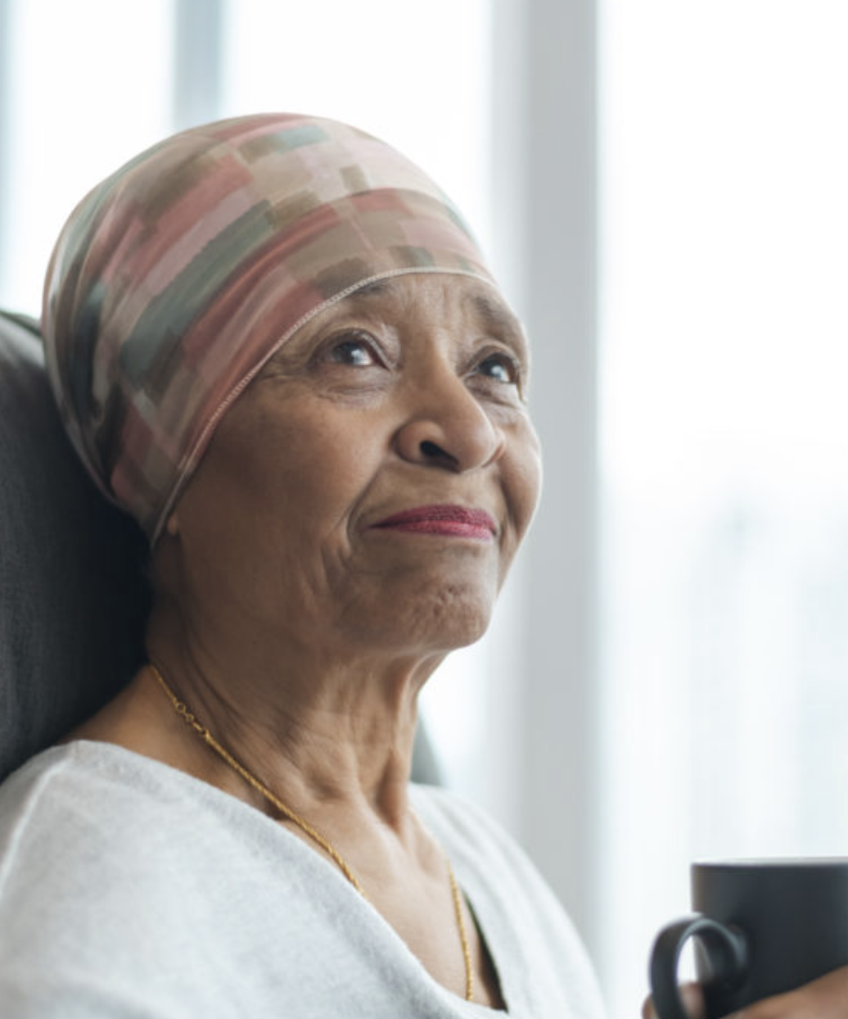
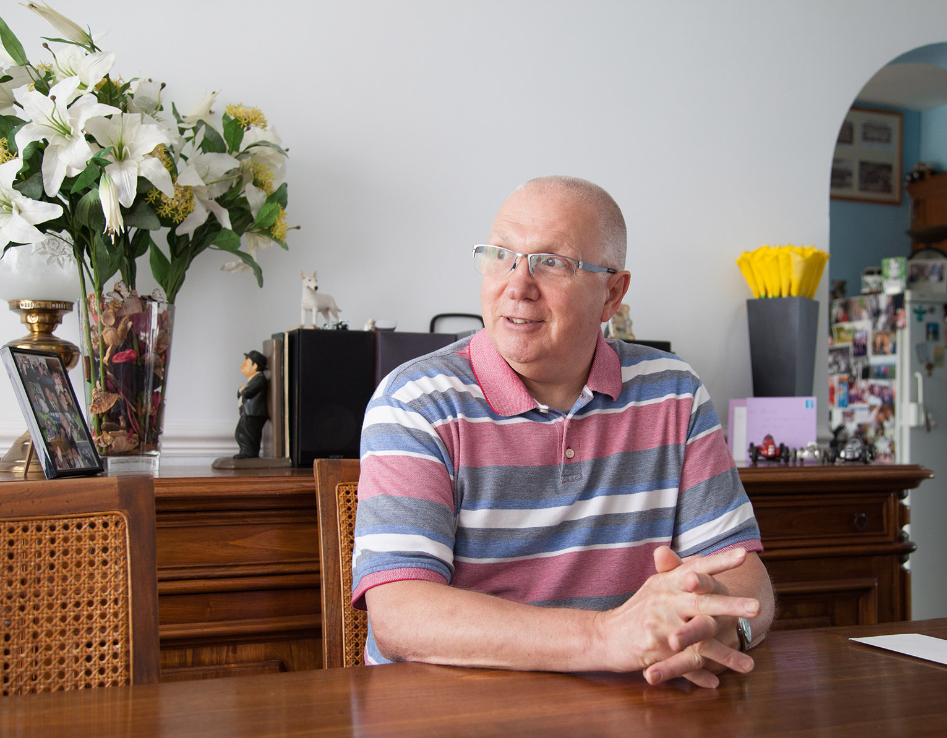
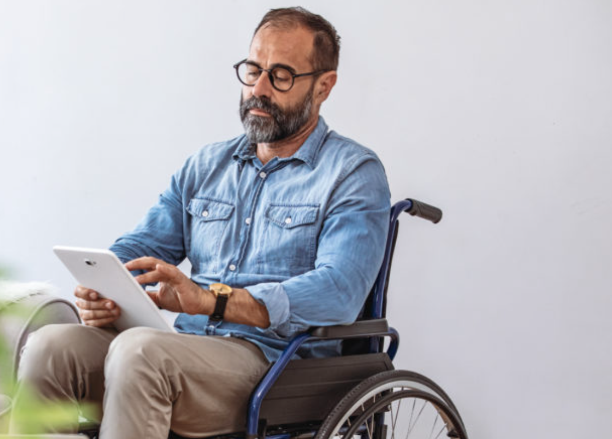
uMotif enhances patients’ clinical trial journey Supporting engagement and retention Delivering high eCOA / ePRO, eConsent compliance

Slide 5

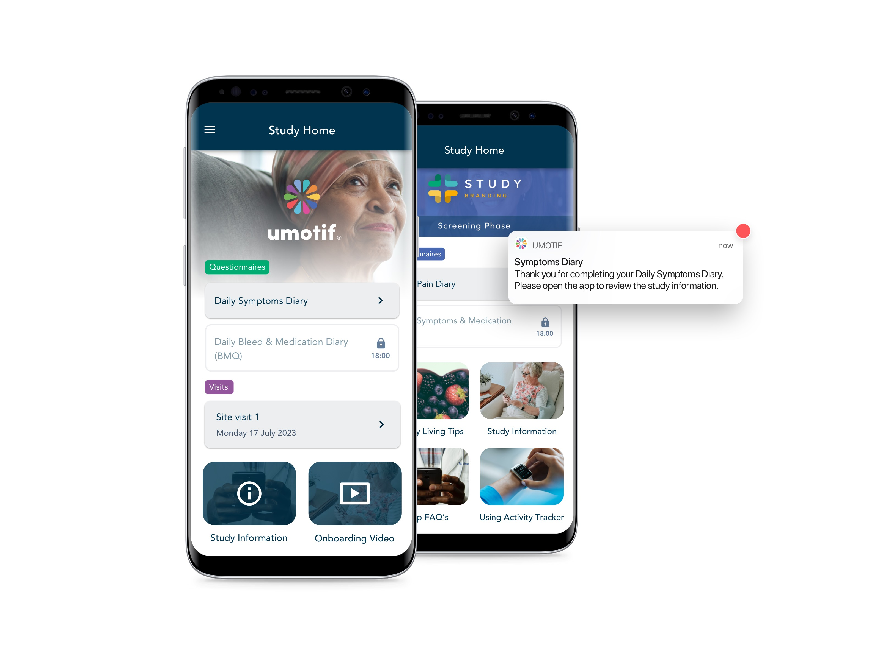
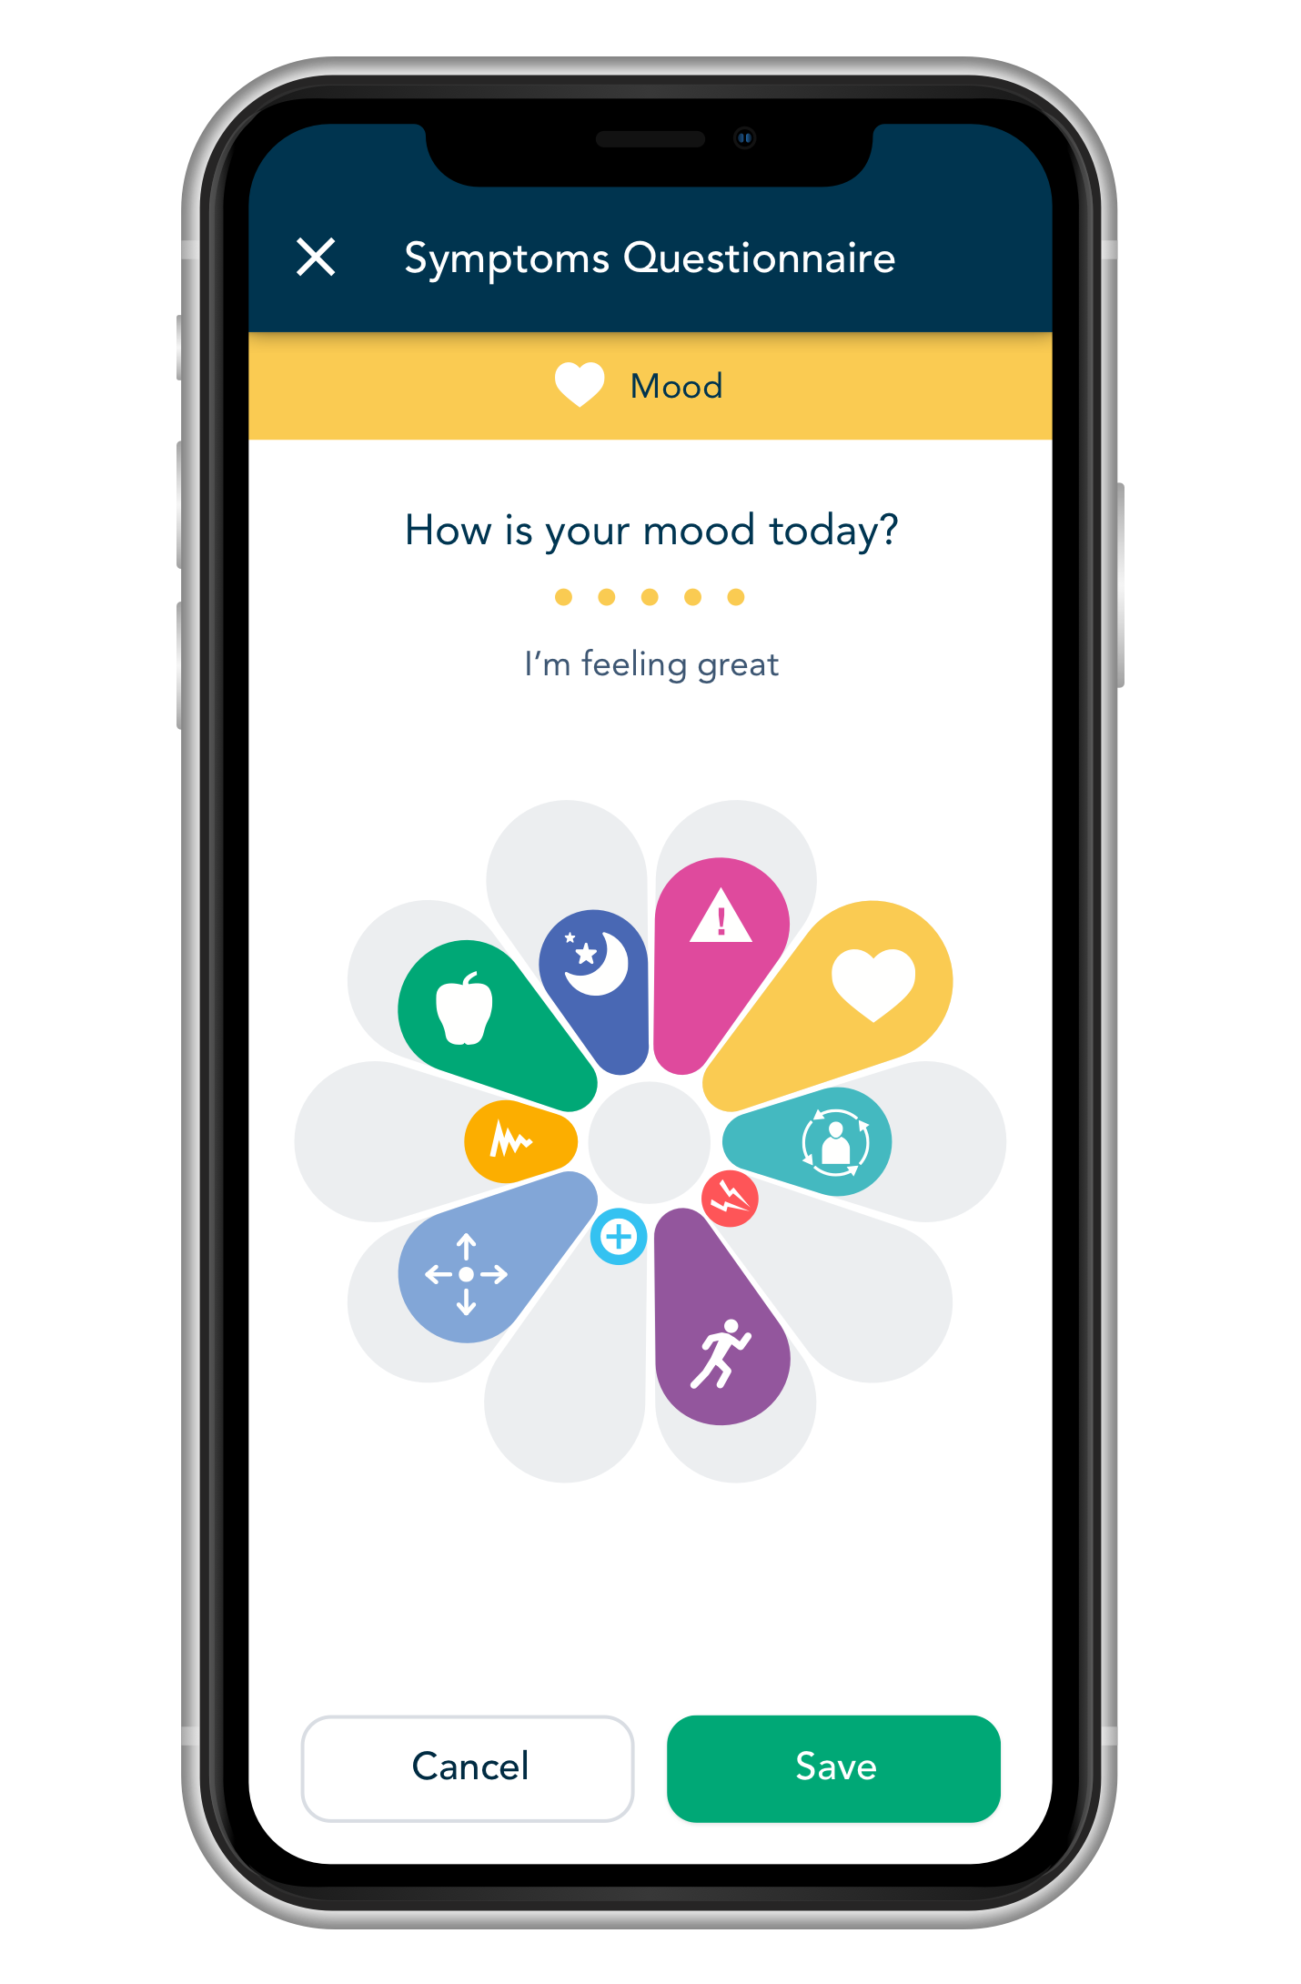
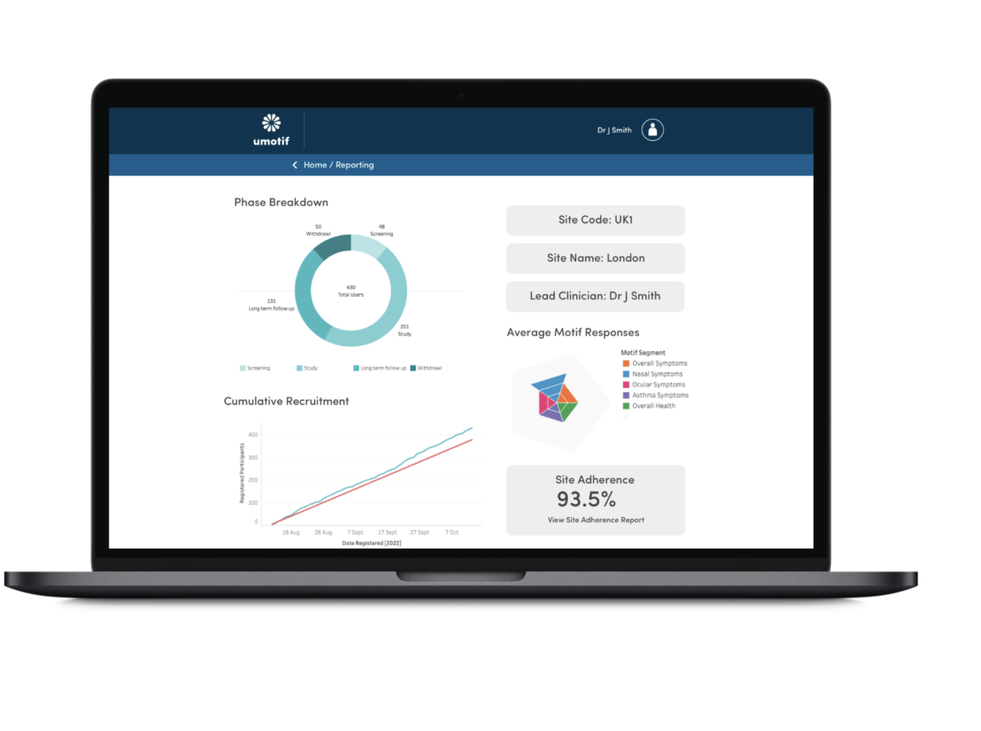

A modern platform for data capture & engagement
Mobile-First Patient Experience
Powerful Professional Reporting Portals
Powerful nudge engine to drive compliance, with video & other content to inform & engage

Slide 6

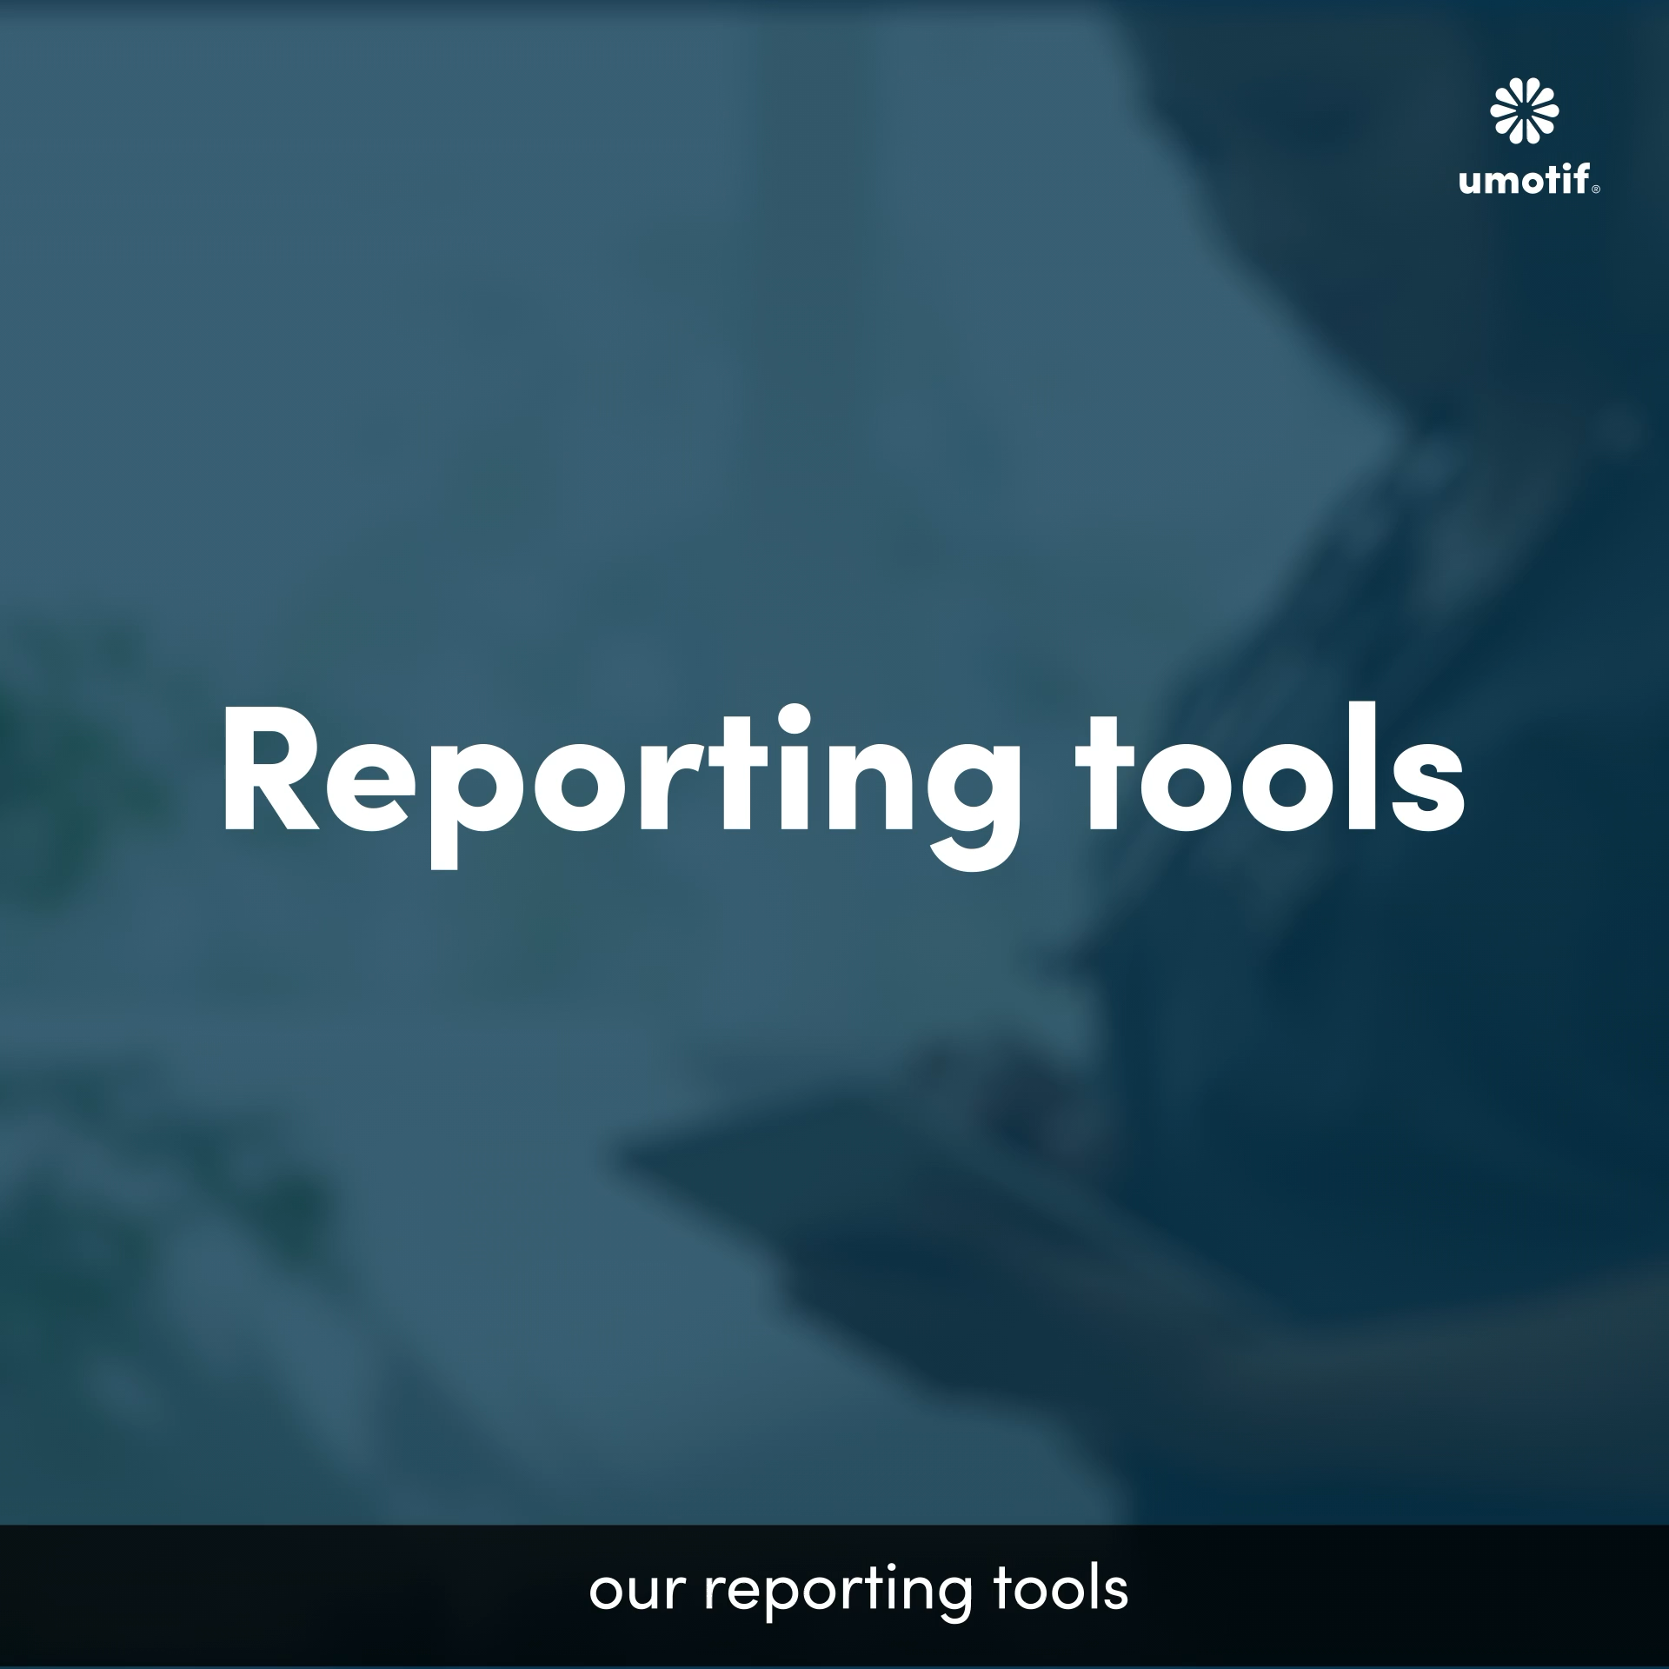
Engaging data capture for participants
Powerful real-time reporting for sites and sponsors

Slide 7
Case study:
Cloudy with a Chance of Pain

Slide 8


Fully virtual pain study
>13,000 participants, fully virtual BYOD study
Exploring relationship between pain and the weather
>5,000 recruited in the first morning
Thousands tracked data daily for over 6 months
Results published in Nature
Patients treated as research partners
Regular updates and mid-study feedback
Created a community of participants

Slide 9

Case Study
Sustained daily participation for over 6 months
94%
of users said
the app was
easy to use
92%
said entering data
was easy
Jan
July
Jan
July
Jan
Study officially
ended
Participants continued to use the app beyond study period

Slide 10
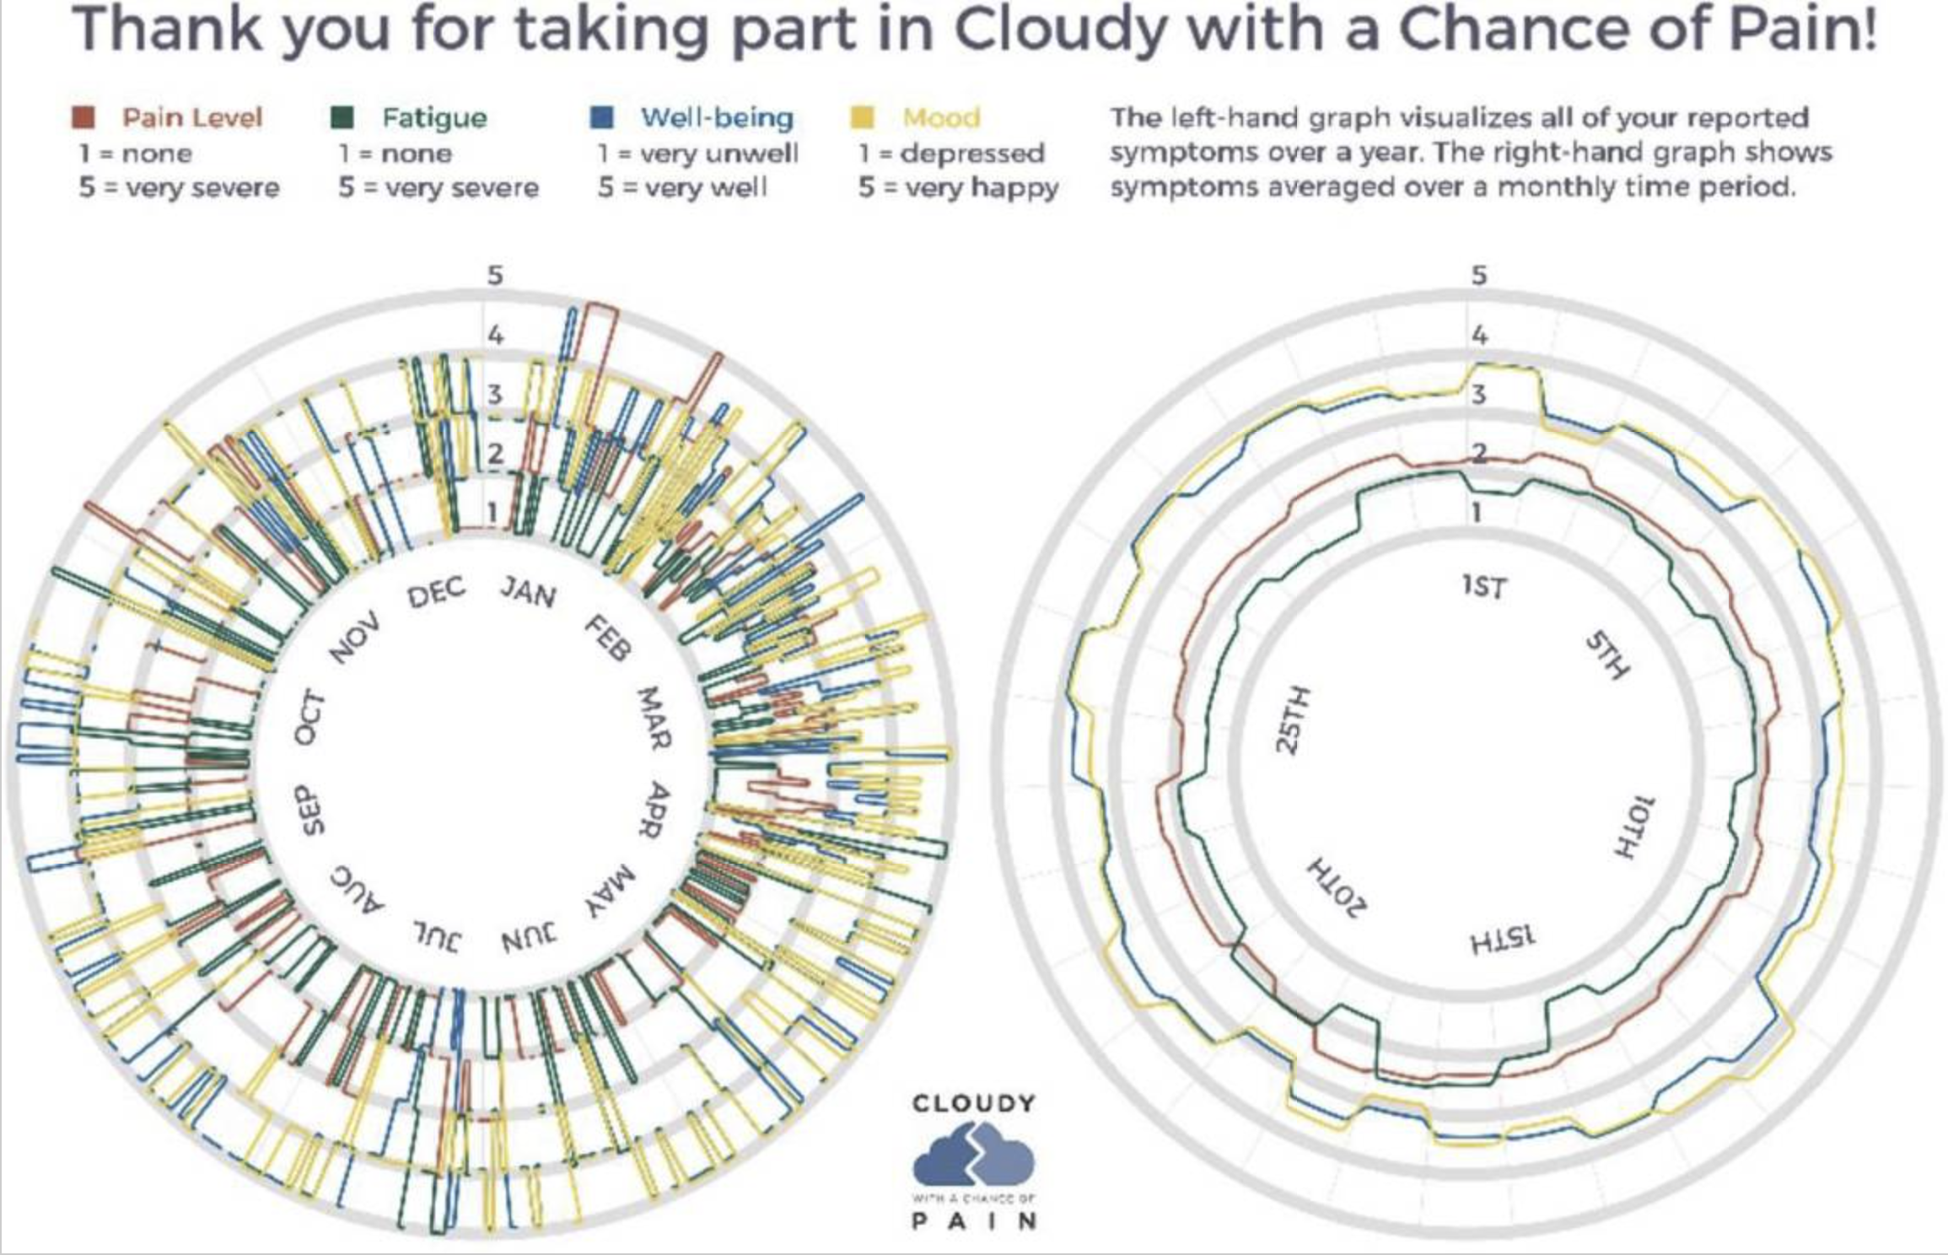
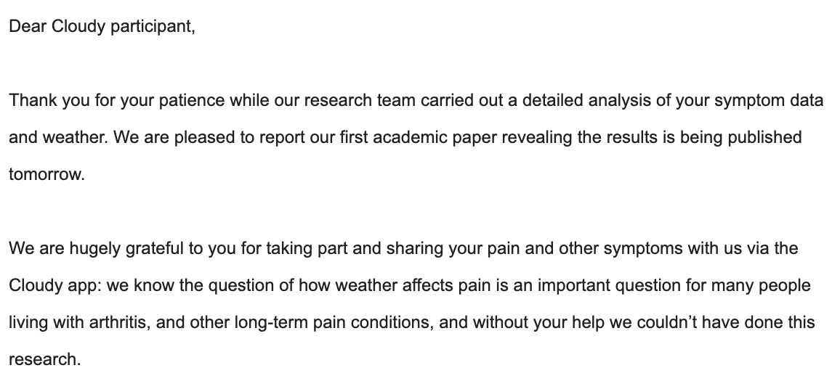
Case Study
Feedback provided to inform, thank and recognise

Slide 11
My Learnings

Slide 12
1. Tech is here now
2. Right partner for right project
3. People want to give
4. Always people-first

Slide 13
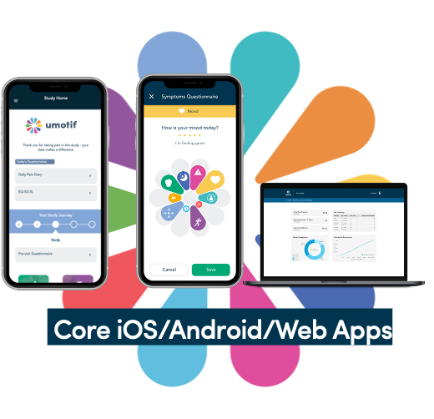

















Proven technology is available now
Tech is built and proven. Key is choosing the right tech to answer the right scientific questions
IVRS / RTSM solutions
Data transfers & tokenization
Study website & pre-screener
Analytics & reporting
eConsent
Study feedback, visit info & schedule
Study onboarding and training
Stipends / reimbursement
eCOA / ePRO / eDiary
Reminders, content & info
Video / photo de-ID
Doc / photo / audio upload
Telehealth
Sensors / wearables

Slide 14
Tech is here now
Right partner for right project
3. People want to give
4. Always people-first

Slide 15
Horses for courses – different technologies are suited to different types of research project
PhD project
Large Academic
Real World Study
Phase II/III clinical trial
To find the right partner:
Be clear on the project ‘must-haves’
Help vendor by giving a budget range
Involve potential partners early
Understand that tech can’t do it all

Slide 16
Tech is here now
Right partner for right project
People want to give
3. People want to give
4. Always people-first

Slide 17
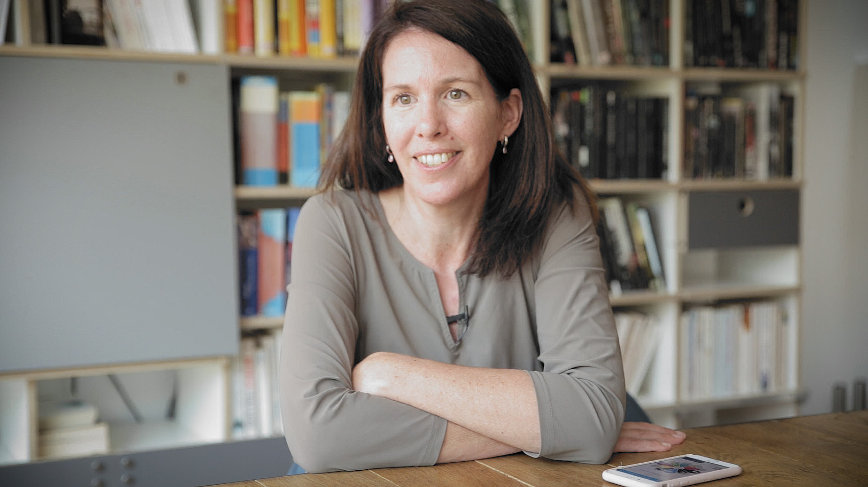
There’s so much data available, if I keep my data locked up inside my own body it’s not going to help anybody
Kathy: participant in Parkinson’s study

Slide 18
Tech is here now
Right partner for right project
People want to give
4. Always people-first

Slide 19
17 BRISTOL 12MINS
89 CORSHAM 25MINS
Bus stop no sign

Slide 20
Things to do
Benefit of doing

Slide 21


Thank You Bruce Hellman bruce@umotif.com

